Slide 1
Urban Area Detection System
with Transfer Learning
Bo-Yan Huang
2024 1/16

Slide 2
Introduction - Background
Contemporary vehicles are equipped with built-in cameras that enable them to perceive their surroundings, and some even possess self-driving capabilities. A car endowed with urban area detection features utilizes cutting-edge sensor technologies and machine learning algorithms. This allows it to smartly identify and react to urban environments, enhancing safety and providing a driving experience finely tuned to the intricacies of city living.
Notes:
Contemporary vehicles are equipped with built-in cameras that enable them to perceive their surroundings, and some even possess self-driving capabilities. A car endowed with urban area detection features utilizes cutting-edge sensor technologies and machine learning algorithms. This allows it to smartly identify and react to urban environments, enhancing safety and providing a driving experience finely tuned to the intricacies of city living.

Slide 3
Introduction - Challenges
Data Quality and Variability: Developing robust machine learning algorithms requires diverse and high-quality training datasets that accurately represent the complexity of urban environments. Obtaining and curating such datasets can be resource-intensive.
Model Generalization: Urban landscapes can be highly diverse, encompassing different architectural styles, road layouts, and infrastructure. Adapting a system to recognize this variability poses a significant challenge.
Real-time Inference: Real-time classification of human activities while managing power consumption on a car device is a critical challenge. The app needs to efficiently process sensor data, make predictions promptly, and operate within the constraints of limited battery resources.

Slide 4
Transfer learning
Transfer learning addresses several challenges associated with building machine learning models, especially when dealing with limited data or specific use cases.
Pre-trained models, which have learned from vast and varied datasets, can capture generic features, patterns, and representations. This knowledge can be transferred and fine-tuned for the specific nuances of urban or rural environments, reducing the need for an exhaustive dataset.
Transfer learning allows leveraging the knowledge acquired by a model on a different but related task. This significantly reduces the need for extensive labeled data, making it possible to achieve good results even with limited data for the new use case.

Slide 5
Transfer learning
Pre-trained Model
ResNet
Last output layer
(Gray)
Input
Images
Output
2048 nodes
…
New output layer
Urban/Rural
Gray: Many layers
Blue: Prediction layer
We're replacing the final layer of the ResNet model with a new dense layer featuring two nodes. One node assesses urban characteristics, and the other evaluates rural qualities. All nodes in the layer before prediction contribute to gauging urban attributes, and connections illustrate these potential relationships. Similarly, the information at each node influences our assessment of the photo's rural characteristics. Finally, we employ softmax to obtain the predicted class.
Notes:
We're replacing the final layer of the ResNet model with a new dense layer featuring two nodes. One node assesses urban characteristics, and the other evaluates rural qualities. All nodes in the layer before prediction contribute to gauging urban attributes, and connections illustrate these potential relationships. Similarly, the information at each node influences our assessment of the photo's rural characteristics.

Slide 6
Flowchart of urban area detection system
Data Preprocessing
Evaluation of the models
Raw data
Model training
A collection of images sized 225x225 pixels with a color depth of 24 bits.
Resizing images
Converting color depth to RGB 256
Rescale the pixel values
Data augmentation
Select a suitable pre-trained model and fine-tune the additional layers to create a new model.
Assess the model to determine if it meets our requirements. If not, revisit the previous step for further refinement.

Slide 7
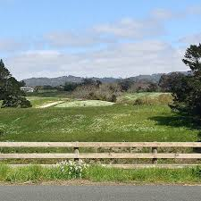
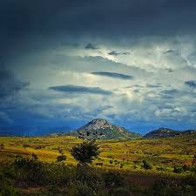
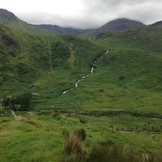
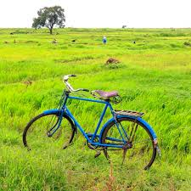
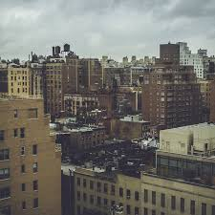
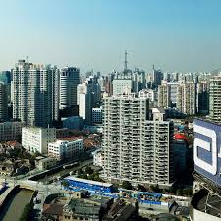
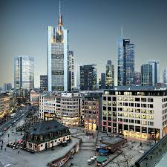
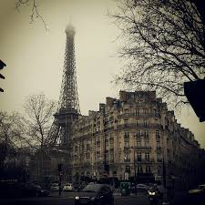
About data
Rural
This dataset consists of images sized 225x225 pixels with a color depth of 24 bits. It was compiled from a Google Image search, encompassing both rural and urban subjects. The search was limited to images in the public domain, specifically those with a 1:1 aspect ratio. This dataset proves valuable for experimenting with diverse image processing techniques.
Urban

Slide 8
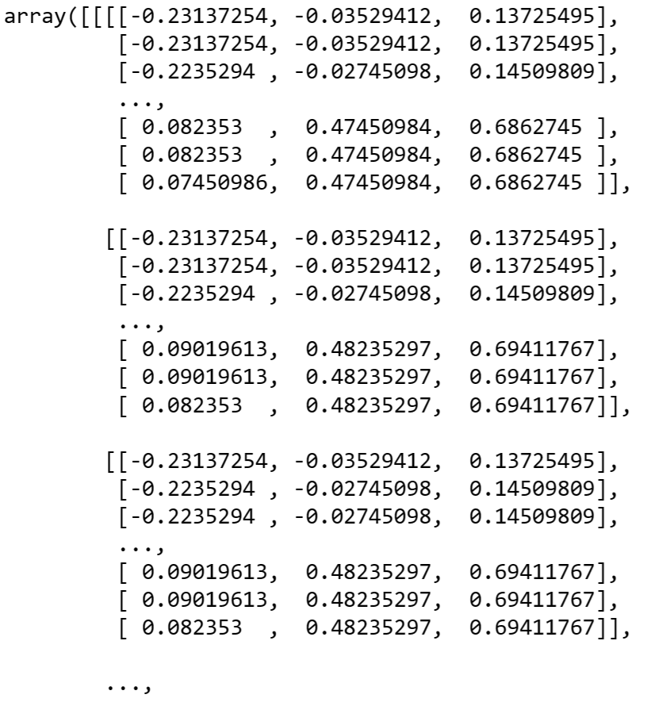
About data
The image will be resized to 224 x 224 x 3 with 256 RGB colors. An example image can be converted into an array with a shape of (12, 224, 224, 3), where 12 represents the batch size, 224 represents the height and width, and 3 represents RGB colors.

Slide 9
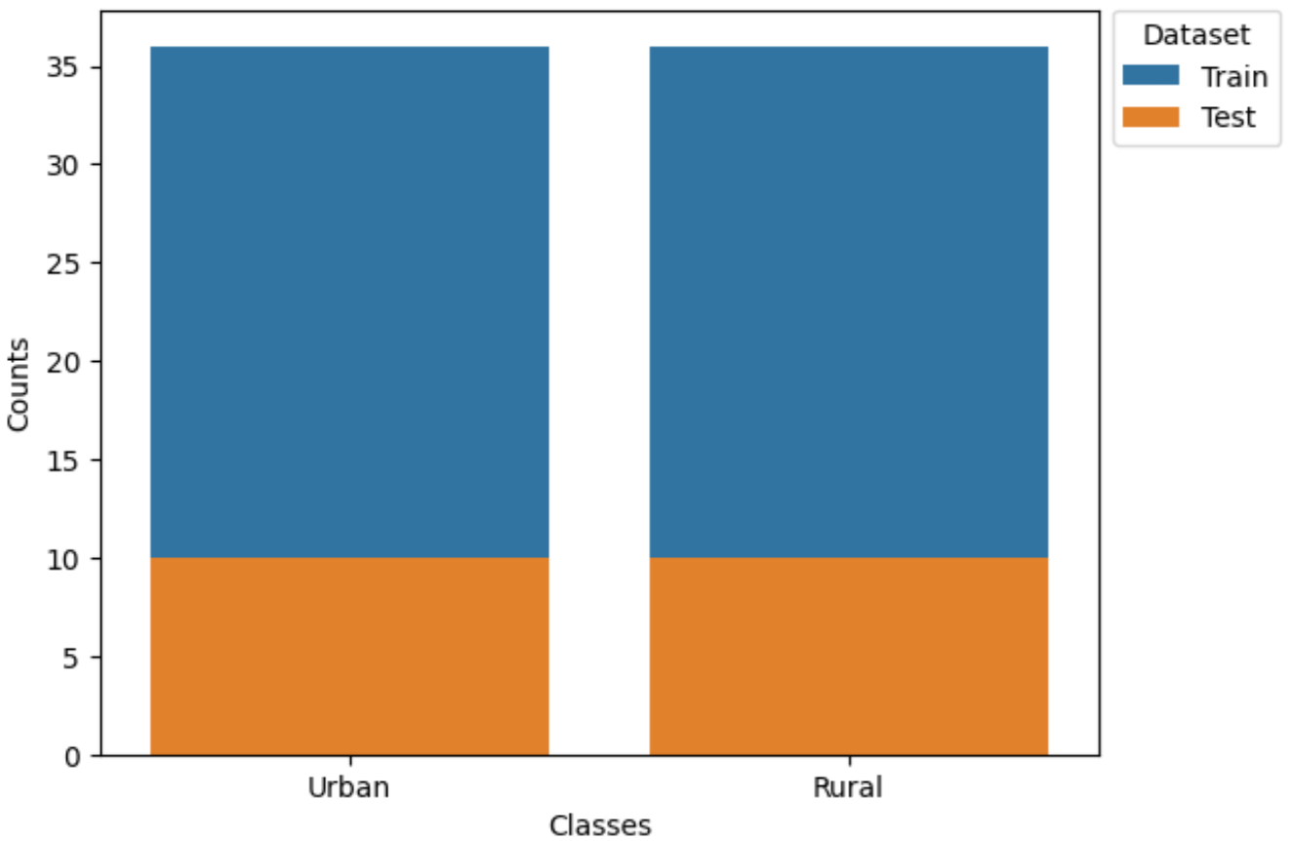
Label counts per category
The dataset is divided into training data, comprising 36 images for each urban and rural scene, and a test set, which incorporates 10 images for each category. The labeling is based on the directory names of the respective image files.
Notes:
The dataset is divided into training data, comprising 36 images for each urban and rural scene, and a test set, which incorporates 10 images for each category. The labeling is based on the directory names of the respective image files.

Slide 10
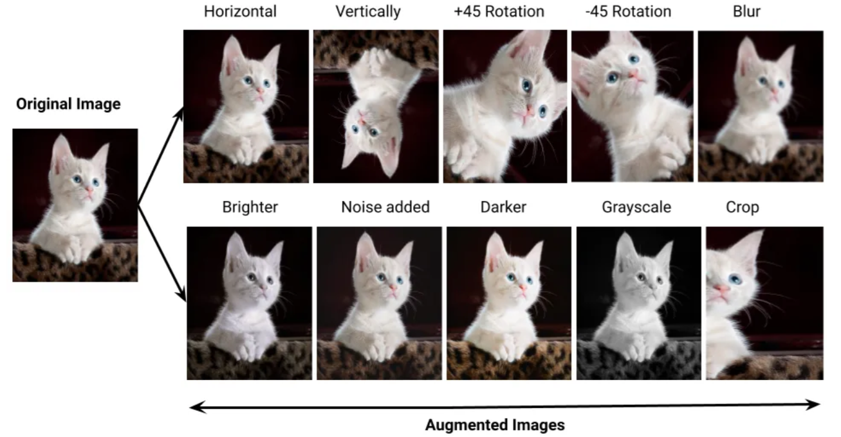
Data augmentation
Data augmentation is a low-cost and effective approach to improving the performance and accuracy of machine learning models in data-constrained scenarios.
In our specific scenario, unrestricted rotation is not feasible due to the necessity for the building to maintain an upright appearance. Nevertheless, horizontal flipping and cropping remains a viable option.
Notes:
Data augmentation presents a cost-effective and efficient method for enhancing the performance and precision of machine learning models, especially in situations with limited data availability. To boost the representation of the "cat" class, one can replicate cat images and mirror them horizontally. Additional modifications, such as rotation, cropping, and translation, can also be applied.
In our specific scenario, unrestricted rotation is not feasible due to the necessity for the building to maintain an upright appearance. Nevertheless, horizontal flipping and cropping remains a viable option. Furthermore, simulating varying weather conditions by adjusting image brightness can contribute to the generation of augmented data, offering the model exposure to diverse environmental factors.

Slide 11
Pre-trained Models
Model | Size (MB) | Top-1 Accuracy | Top-5 Accuracy | Parameters | Depth | Time (ms) per inference step (CPU) | Time (ms) per inference step (GPU)
Xception | 88 | 79.0% | 94.5% | 22.9M | 81 | 109.4 | 8.1
VGG16 | 528 | 71.3% | 90.1% | 138.4M | 16 | 69.5 | 4.2
VGG19 | 549 | 71.3% | 90.0% | 143.7M | 19 | 84.8 | 4.4
ResNet50 | 98 | 74.9% | 92.1% | 25.6M | 107 | 58.2 | 4.6
ResNet50V2 | 98 | 76.0% | 93.0% | 25.6M | 103 | 45.6 | 4.4
ResNet101 | 171 | 76.4% | 92.8% | 44.7M | 209 | 89.6 | 5.2
ResNet101V2 | 171 | 77.2% | 93.8% | 44.7M | 205 | 72.7 | 5.4
InceptionV3 | 92 | 77.9% | 93.7% | 23.9M | 189 | 42.2 | 6.9
Keras Applications offer pre-trained deep learning models with accompanying weights. These models serve various purposes, including prediction, feature extraction, and fine-tuning.
The the table to the left displays some of the available pre-trained models. For the complete list, refer to https://keras.io/api/applications/.
Notes:
Next, we choose ResNet, pre-trained on ImageNet, an extensive image dataset consisting of over 14 million images spanning thousands of categories.
Keras makes available several models that have been pre-trained on this dataset here.

Slide 12
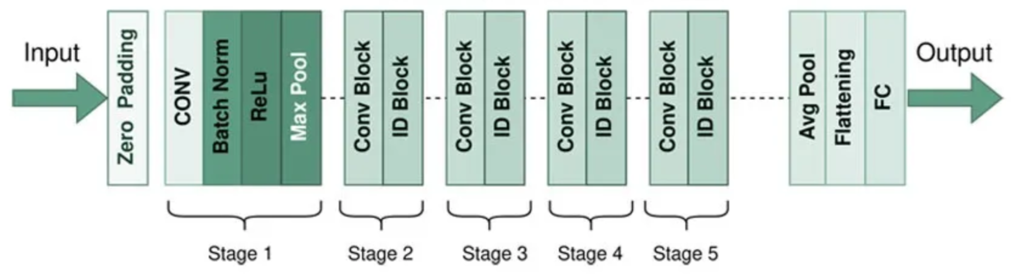
ResNet50
The Residual networks (ResNet in short) architecture is one of the most well known and popular networks in the literature, introduced by Microsoft Reseach in 2015 in the paper written by He. et. al. The residual networks proposed in this paper won the first places on ILSVRC 2015 classification task, ImageNet detection, ImageNet localization, COCO detection and COCO segmentation task.

Slide 13
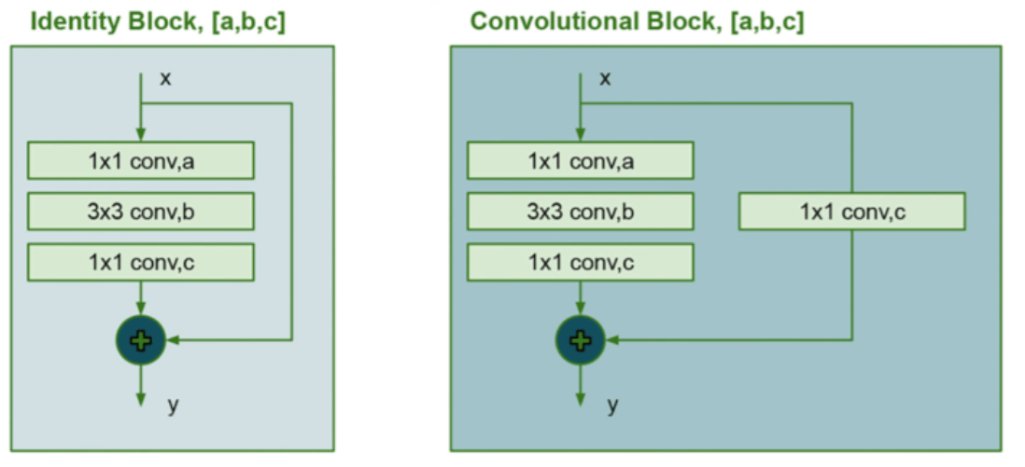
ResNet50
The identity block is a residual block that preserves the input information by bypassing the identity of the input directly to the output. It consists of three main layers: two convolutional layers with smaller filter sizes and a batch normalization layer. These layers operate in a sequence without any skip connections. The skip connection helps mitigate the vanishing gradient problem, facilitating the flow of gradients during backpropagation.
The convolutional block, also known as a residual block with a convolutional shortcut, includes a convolutional layer in the shortcut connection. It involves three layers: a convolutional layer with a larger filter size, a batch normalization layer, and a rectified linear unit (ReLU) activation function. The convolutional shortcut provides an alternative route for gradient flow, enhancing the ability of the network to learn complex features.
+
+

Slide 14
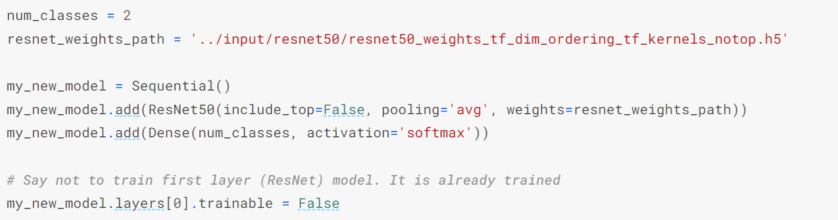
ResNet50
We categorize photos into two classes: urban and rural, denoted as num_classes. Moving on to building the model, we configure a sequential model to which we can add layers. Initially, we incorporate a pre-trained ResNet model. By setting include_top=False during the ResNet model creation, we indicate the exclusion of its last prediction-making layer. Additionally, we use a file without the weights for that layer.
The argument pooling='avg' specifies that, if there are extra channels in the tensor at the end of this step, we want to condense them into a 1D tensor by taking an average. This results in a pre-trained model that generates the layer depicted in the graphic. Subsequently, we add a Dense layer for predictions, specifying the number of nodes in alignment with the number of classes. Finally, we apply the softmax function to generate probabilities.

Slide 15
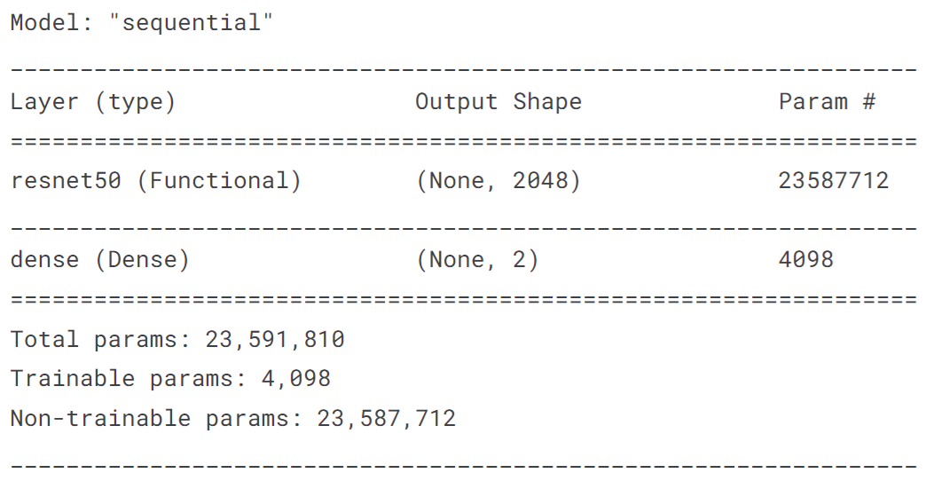
ResNet50
The parameters from ResNet are frozen, allowing only the last layer to be trainable. Therefore, the total number of trainable parameters is equal to twice the number of nodes in the last layer (2 * 2048), resulting in 4096 parameters.
We employ stochastic gradient descent (SGD) to minimize the categorical cross-entropy loss. Additionally, we instruct the code to provide the accuracy metric, representing the fraction of correct predictions. This metric is more straightforward to interpret compared to categorical cross-entropy scores, making it beneficial to print and assess the model's performance.
Notes:
The parameters from ResNet are frozen, allowing only the last layer to be trainable. Therefore, the total number of trainable parameters is equal to twice the number of nodes in the last layer (2 * 2048), resulting in 4096 parameters.
We employ stochastic gradient descent (SGD) to minimize the categorical cross-entropy loss. Additionally, we instruct the code to provide the accuracy metric, representing the fraction of correct predictions. This metric is more straightforward to interpret compared to categorical cross-entropy scores, making it beneficial to print and assess the model's performance.

Slide 16
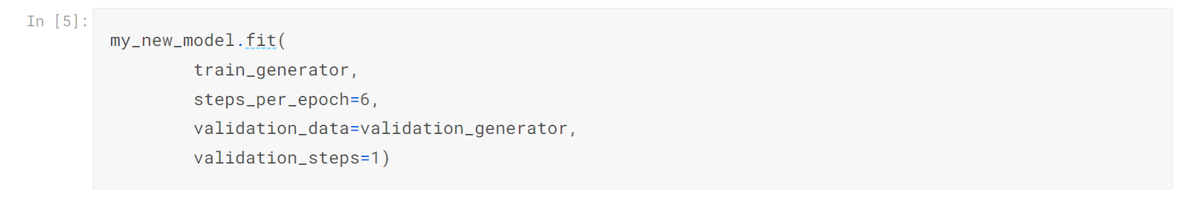
ResNet50 Results
Without data augmentation:
With data augmentation:
Notes:
The displayed validation accuracy may appear significantly better than the training accuracy during this stage, which might be initially perplexing.
This discrepancy arises because the training accuracy is computed at various intervals as the neural network undergoes improvement (the numbers in the convolutions were being updated to make the model more accurate). When the model encounters the initial training images, the weights haven't undergone extensive training or improvement yet, impacting the initial training accuracy calculation. These initial results are then averaged into the overall measure.
In contrast, validation loss and accuracy metrics are calculated after the model has processed the entire dataset. At this point, the network has undergone complete training, resulting in the calculation of these scores.
While this difference can be puzzling at first, it is not a significant concern in practice, and it is typically not a cause for worry.
After implementing data augmentation, we observed improved results using the same training data.

Slide 17
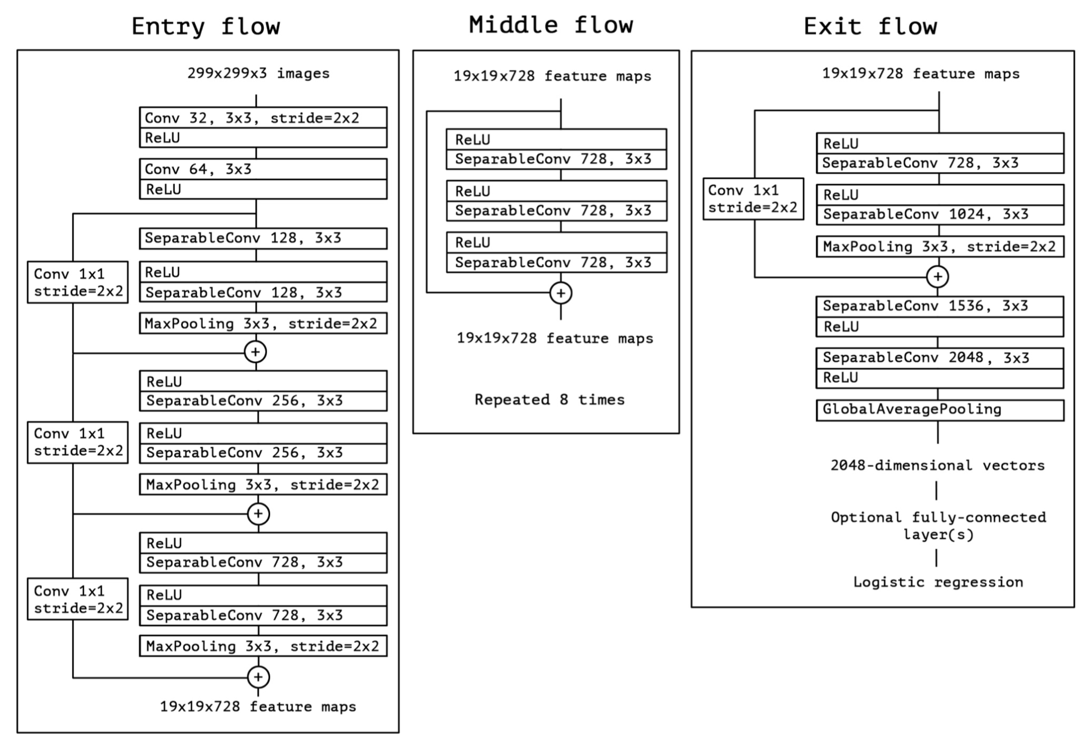
Xception
Let's delve into another pre-trained model to evaluate the efficacy of transfer learning. Xception, which was emphasized in the previous slide as the most accurate model, achieves a top-1 accuracy of 79% and a top-5 accuracy of 94.5%. Derived from InceptionV3, the Xception model is named for its adapted method, Extreme Inception.
In Xception Model, the data frist goes through the entry flow, then through the middle flow which is repeated eight times, and finally through the exit flow. The architecture is shown to the left.
Input
Entry flow
Middle flow (x8)
Exit flow
Output

Slide 18
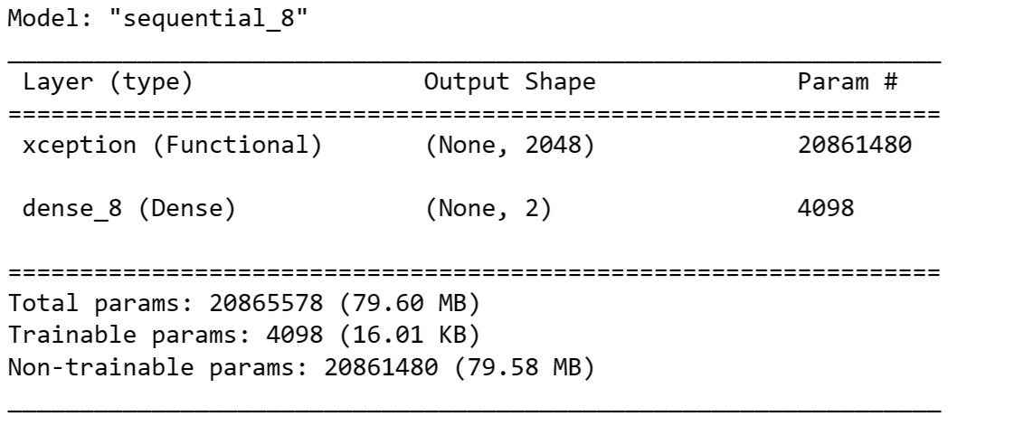
Xception
The total number of trainable parameters is equal to twice the number of nodes in the last layer (2 * 2048), resulting in 4096 parameters.
Similar to previous the previous configuration, we utilize stochastic gradient descent (SGD) to minimize categorical cross-entropy loss. We also specify the accuracy metric in the code, offering a more easily interpretable measure of the model's performance in terms of correct predictions, as opposed to categorical cross-entropy scores.
Notes:
The training and validation accuracies are 70% and 85%, respectively. Similar to the previously shown results, the displayed validation accuracy appears notably better than the training accuracy for the same reasons. While the accuracy may be lower than the previous model, it still surpasses a random guess (50%), indicating the efficacy of transfer learning.

Slide 19
Xception Results
With data augmentation:
Notes:
The accuracy on training and validation data are 70% and 85% respectively.
The displayed validation accuracy appear significantly better than the training accuracy as showed previously, where the same reason apply.
Although the accuracy seems lower than the previous one, it is still considerably higher than a random guess (50%), which shows that transfer learning works well.

Slide 20
Compare the performance of models
Pre-trained Model | Accuracy on Testing dataset | Accuracy on Training dataset | Training time
ResNet50 | 100% | 90% | 6s
Xception | 85% | 71% | 5s
Notes:
We have evaluated two well-known pre-trained models, ResNet50 and Xception. The "Random" classifier, operating as a completely random predictor, generates predictions with a 50/50 split between rural and urban classes.
For ResNet, the accuracy on the training and validation data is approximately 90% and 100%, respectively, raising concerns about potential overfitting. It is anticipated that the accuracy for ResNet will decrease with an increase in the training data.
For Xception, the accuracy on the training and validation data is approximately 71% and 85%, respectively. While this accuracy might seem lower than ResNet, it significantly surpasses a random guess (50%), showcasing the efficacy of transfer learning. Given the relatively small size of the training dataset, an improvement in accuracy is anticipated with an increase in training data.
Nevertheless, the performance achieved is quite remarkable considering the limited size of the dataset.

Slide 21
Conclusions
The effectiveness of transfer learning becomes apparent when employed for a new task. The resulting model predicts whether an image belongs to a rural or urban category with satisfactory accuracy.
Transfer learning allows us to train only the additional layers, significantly reducing both training time and the computational resources required.
Even a small dataset can suffice for training a satisfactory model.
Data augmentation enhances the performance and robustness of machine learning models by artificially expanding the dataset and exposing the model to a diverse range of input variations.

Slide 22
Outlook
Possible issues:
Limited Representations: The pre-trained model may not have encountered sufficient diversity in the small dataset (ex. the weather are basically the same in the rural dataset), limiting its ability to represent the full range of variations in the new task.
Fine-tuning Challenges: With a small dataset, fine-tuning the pre-trained model's parameters may be challenging. The model might not converge effectively, or it may be sensitive to hyperparameter choices.
Transferability of Features: The features learned on a large dataset may not be as transferable to a small, task-specific dataset. The relevance of pre-trained features may be diminished if the new task requires unique or specific representations.
Domain Shift: If there is a significant domain shift between the pre-training dataset and the new task dataset, the transferred knowledge may not align well with the target task.

Slide 23
Outlook
Possible solutions:
Limited Representations: We need to correct more images encompassing various weather conditions, day and night settings, and different seasons.
Fine-tuning Challenges: Expanding the dataset using data augmentation techniques can alleviate problems associated with fine-tuning.
Transferability of Features: Explore alternative pre-trained models that have been trained on datasets similar to the one used in our task. Additionally, consider models that have been trained for comparable tasks.
Domain Shift: Regularly evaluate the model's performance on the target domain during training. Monitor domain shift indicators and adjust models accordingly.

Slide 24
Appendix
Data source: https://www.kaggle.com/datasets/dansbecker/urban-and-rural-photos
Pre-trained models: https://keras.io/api/applications/
Courses: https://www.coursera.org/learn/deep-learning-reinforcement-learning/home
Jupyter notebook:
https://github.com/r95222023/IBM-Machine-Learning-Professional-Certificate/tree/main/Deep%20Learning%20and%20Reinforcement%20Learning

